Slide 1
Introduction to GPU
Dr. Nausheen Shoaib

Slide 2
CPU
Single Core CPUs
Flexible
Performance
How to squeeze more functionality?
Power Hungary
Memory CPU speed disparity
Instruction Level Parallelism
Pipelining
Super Scalar
Multi-Cores CPUs
Instead of adding complexity to a single core we scale cores in the same dimensions of the silicon
Current Multi-Cores
Do we need more?
Vector Processing Units (VPUs),
Graphic Processing Units (GPUs),
Associative Processing Units (APUs),
Tensor Processing Units (TPUs)
Field Programmable Gate Arrays (FPGAs),
Quantum Processing Units (QPUs)

Slide 3
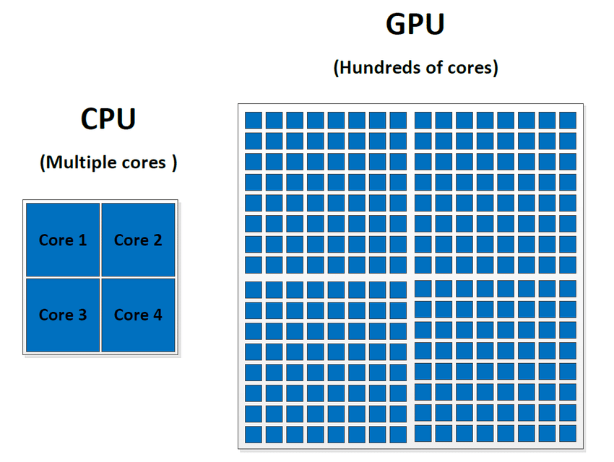
Graphic Processing Units (GPUs)
More HW for Computation
Many Cores
More power efficient
Restricted Programming Model
GPUs were originally designed to accelerate the rendering of 3D graphics. Over time, they became more flexible and programmable, enhancing their capabilities.
This allowed graphics programmers to create more interesting visual effects and realistic scenes with advanced lighting and shadowing techniques.
Other developers also began to tap the power of GPUs to dramatically accelerate additional workloads in high performance computing (HPC), deep learning, and more.

Slide 4
Latency vs Throughput
Latency
Minimize time of one task
Metric: seconds
Focus of CPU
Throughput
Maximize stuff per time
Metric: jobs/hour, pixels/sec
Focus of GPUs

Slide 5
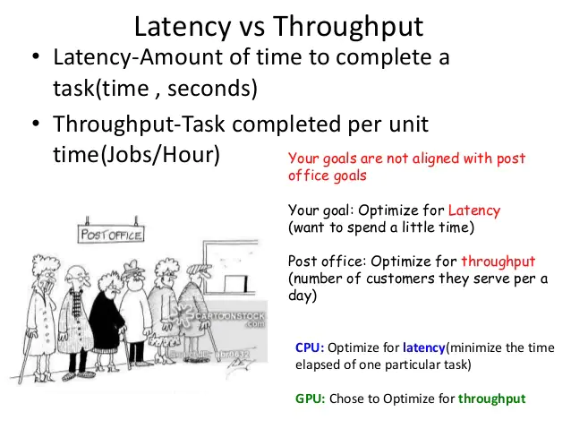

Slide 6
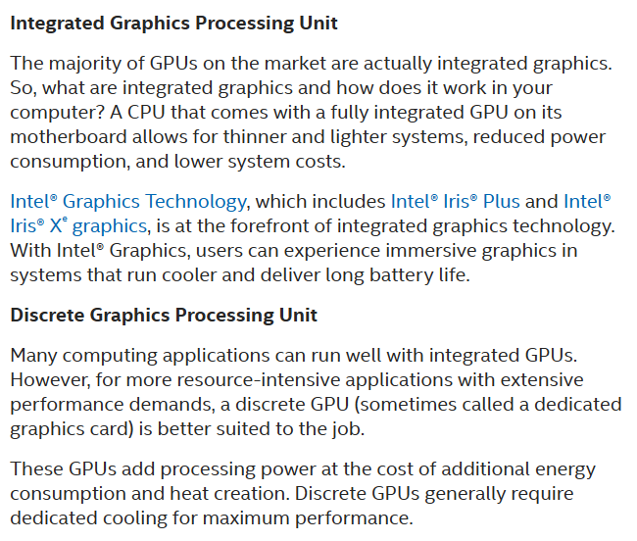
https://www.intel.com/content/www/us/en/products/docs/processors/what-is-a-gpu.html

Slide 7
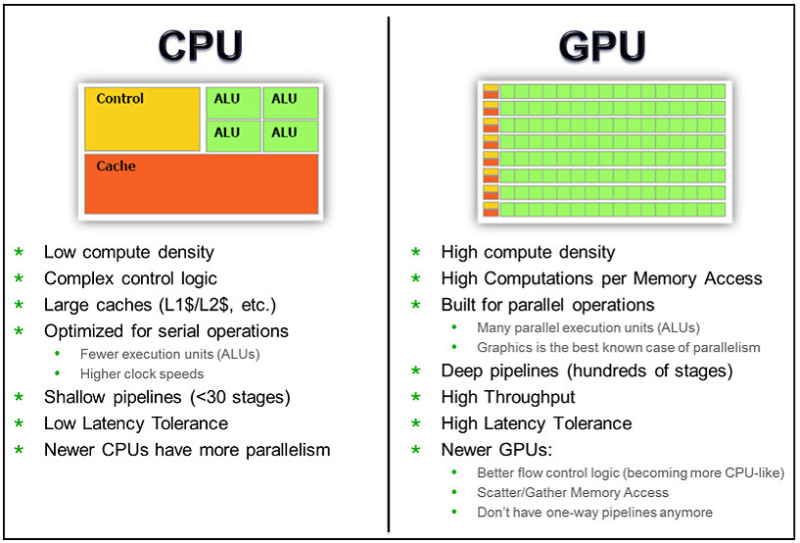

Slide 8
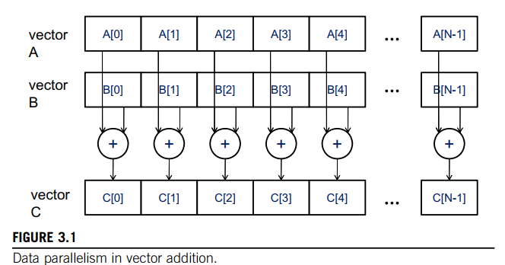
How GPU increases throughput?

Slide 9
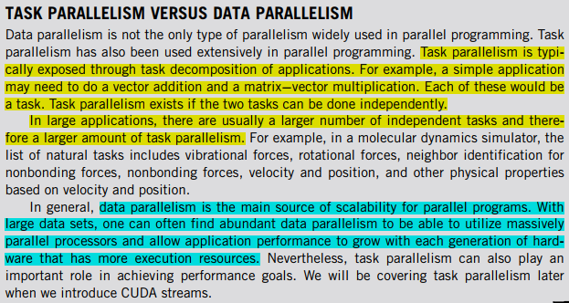

Slide 10
CUDA PROGRAM STRUCTURE
Structure of a CUDA program reflects the coexistence of a host (CPU) and one or more devices (GPUs)
s

Slide 11
A VECTOR ADDITION KERNEL

Slide 12
Vector Addition Kernel Code

Slide 13
DEVICE GLOBAL MEMORY AND DATA TRANSFER

Slide 14
DEVICE GLOBAL MEMORY AND DATA TRANSFER

Slide 15
Vector Addition Using CudaMemcpy

Slide 16
KERNEL FUNCTIONS AND THREADING
When a host code launches a kernel, the CUDA runtime system generates a grid of threads that are organized in a two-level hierarchy.
Each grid is organized into an array of thread blocks, which will be referred to as blocks for brevity.
All blocks of a grid are of the same size; each block can contain up to 1,024 threads.

Slide 17
KERNEL FUNCTIONS AND THREADING
Figure shows each block consists of 256threads. The number of threads in each thread block is specified by the host code when a kernel is launched.
The value of the blockDim.x variable is 256.In general, the dimensions of thread blocks should be multiples of 32 due to hardware efficiency reasons

Slide 18
KERNEL FUNCTIONS AND THREADING
a data index i is calculated as i5blockIdx.x blockDim.x 1 threadIdx.x. Since blockDim is 256 in our example, the i values of threads in block0 ranges from 0 to 255. The i values of threads in block1 range from 256 to 511.
The i values of threads in block 2 range from 512 to 767. That is, the i values of the threads in these three blocks for continuous coverage of the values from 0 to 767. Since each thread uses i to access d_A, d_B, and d_C, these threads cover the first 768 iterations of the original loop. By launching the kernel with a larger number of blocks, one can process larger vectors.

Slide 19
KERNEL FUNCTIONS AND THREADING
A vector addition kernel function and its launch statement

Slide 20
KERNEL FUNCTIONS AND THREADING
CUDA C keywords for function declaration

